Slide 1

Spark application and Life cycle

Slide 2
Spark application and Life cycle
A life cycle consists of several stages
Environment setup
Application development
Job submission
Task execution
Monitoring and debugging
Job completion
Cleanup

Slide 3
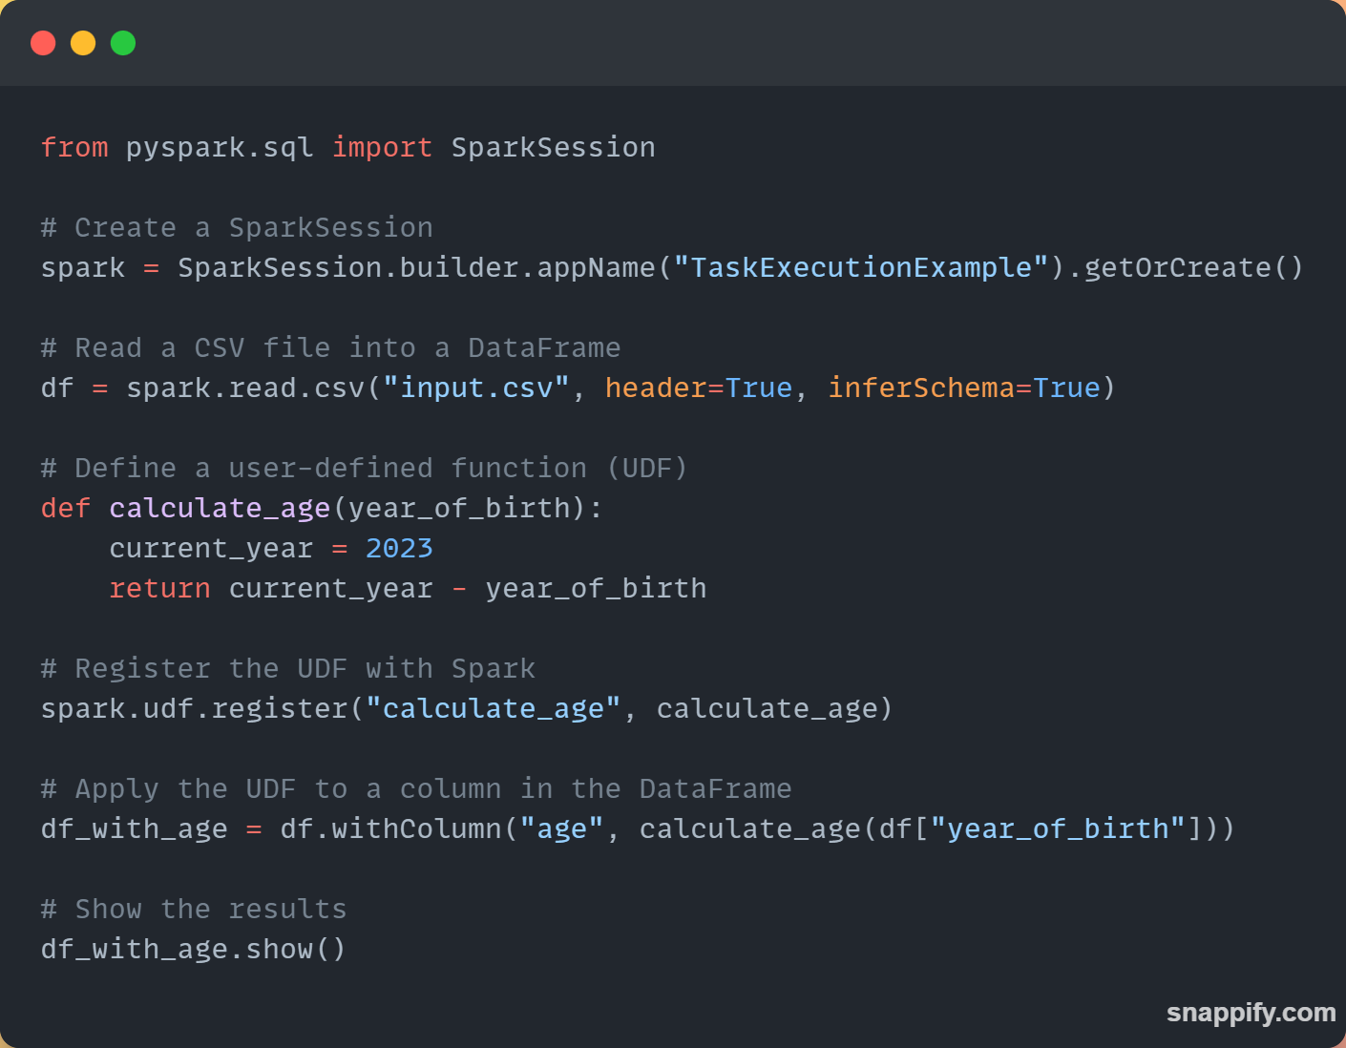
Task execution
Create a set of executors
A job is divided into stages and the stages into tasks
Each task is assigned to executor
Executor runs the task on the data assigned
The data is processed into intermediate results
The results are shuffled and aggregated

Slide 4
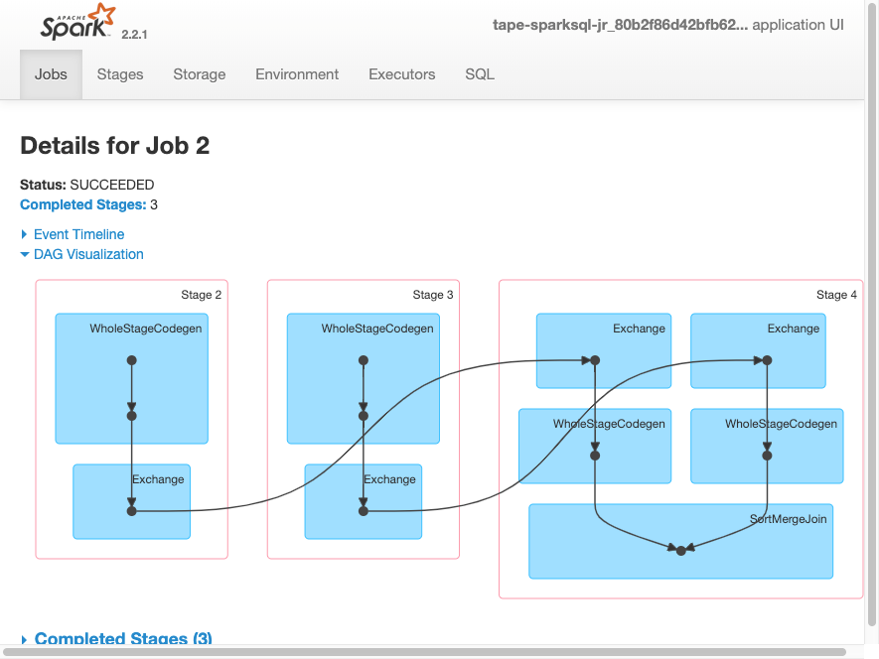
Monitoring and Debugging
Source: https://go.aws/3M2MolK
These 2 components are important aspects of PySpark Applications
Monitoring - This involves collecting metrics of performance; e.g.
CPU/memory usage, network traffic, job status, etc.
Helpful for finding bottlenecks

Slide 5
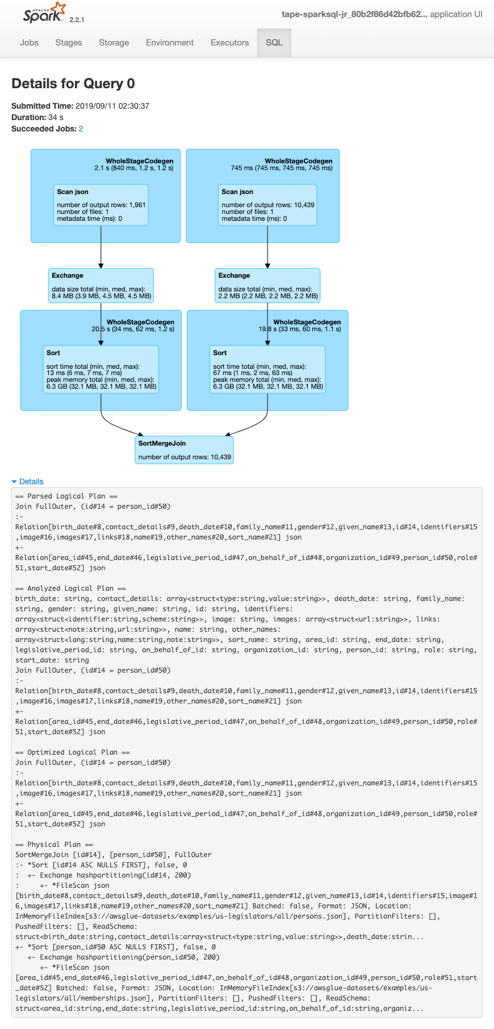
Monitoring and Debugging
Source: https://go.aws/3M2MolK
2. Debugging
The process of finding and fixing errors in the application.
It involves examining code, logs, and other data.

Slide 6
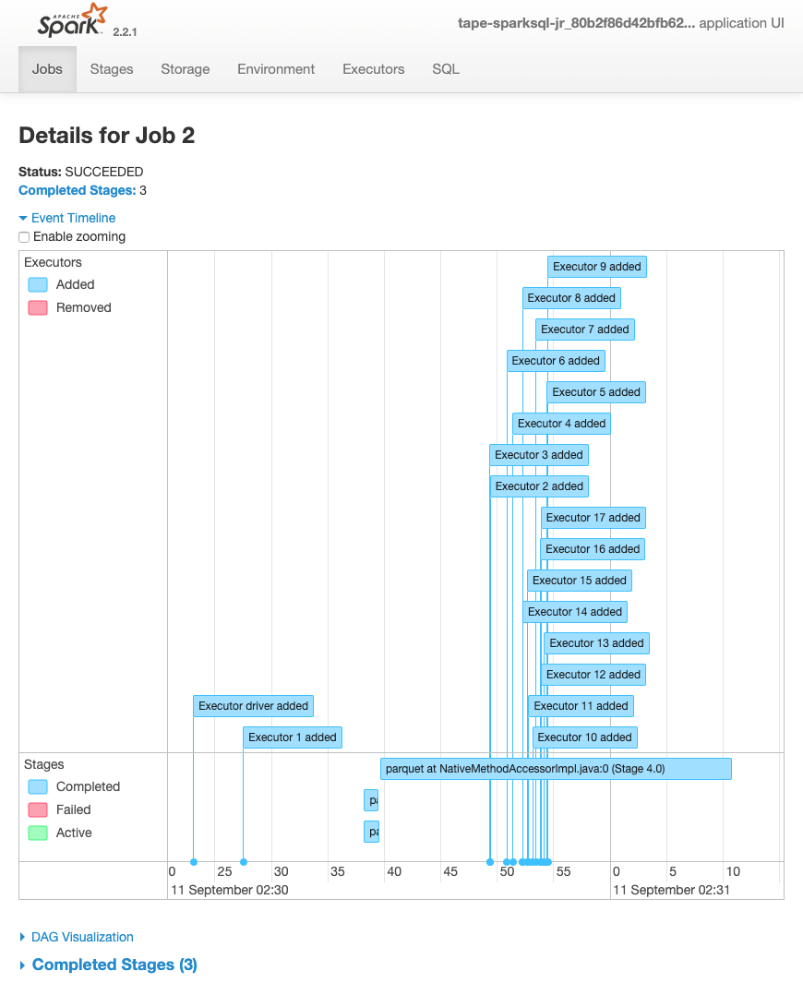
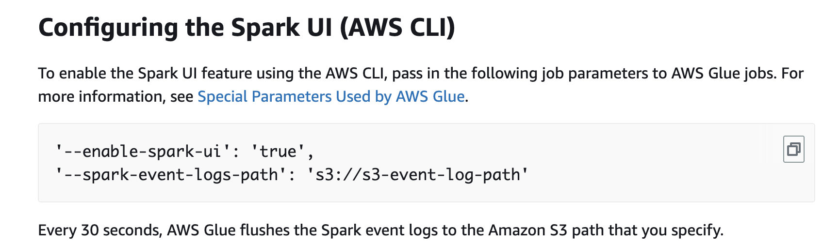
Tools for Monitoring and debugging
Source: https://go.aws/3M2MolK
Spark Web UI:
Provides Real time information
Configuring Spark UI on AWS Glue example:

Slide 7
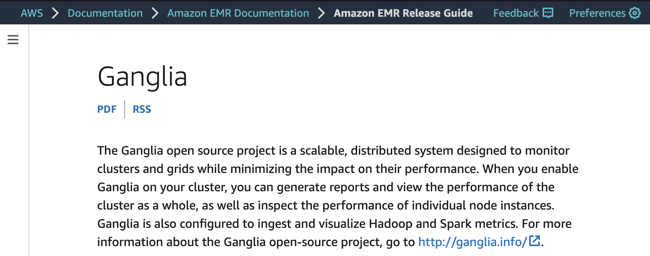
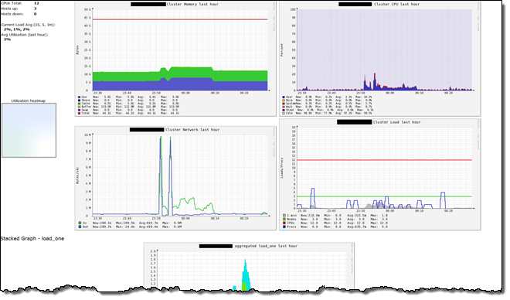
Tools for Monitoring and debugging
Spark monitoring tools; i.e. Ganglia / Graphite / Prometheus, used for data collection and metrics related to performance

Slide 8
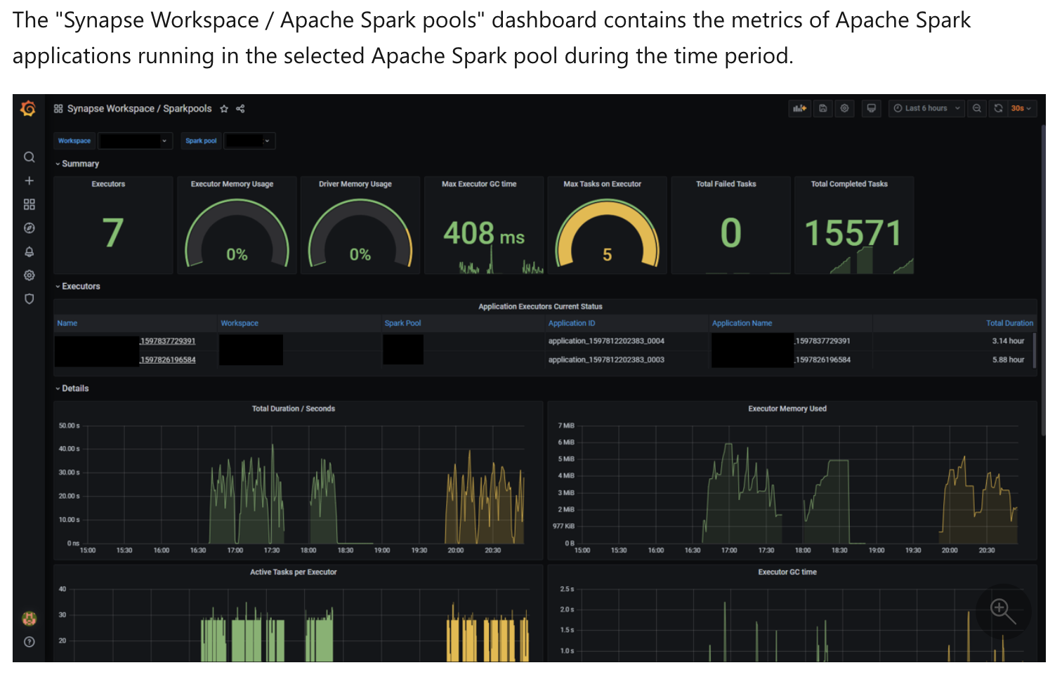
Tools for Monitoring and debugging
Spark Web UI
Provides Real time information
Spark monitoring tools
Ganglia / Graphite / Prometheus used for data collection and metrics related to performance
Source: Microsoft Learn, URL https://bit.ly/41clbBB

Slide 9
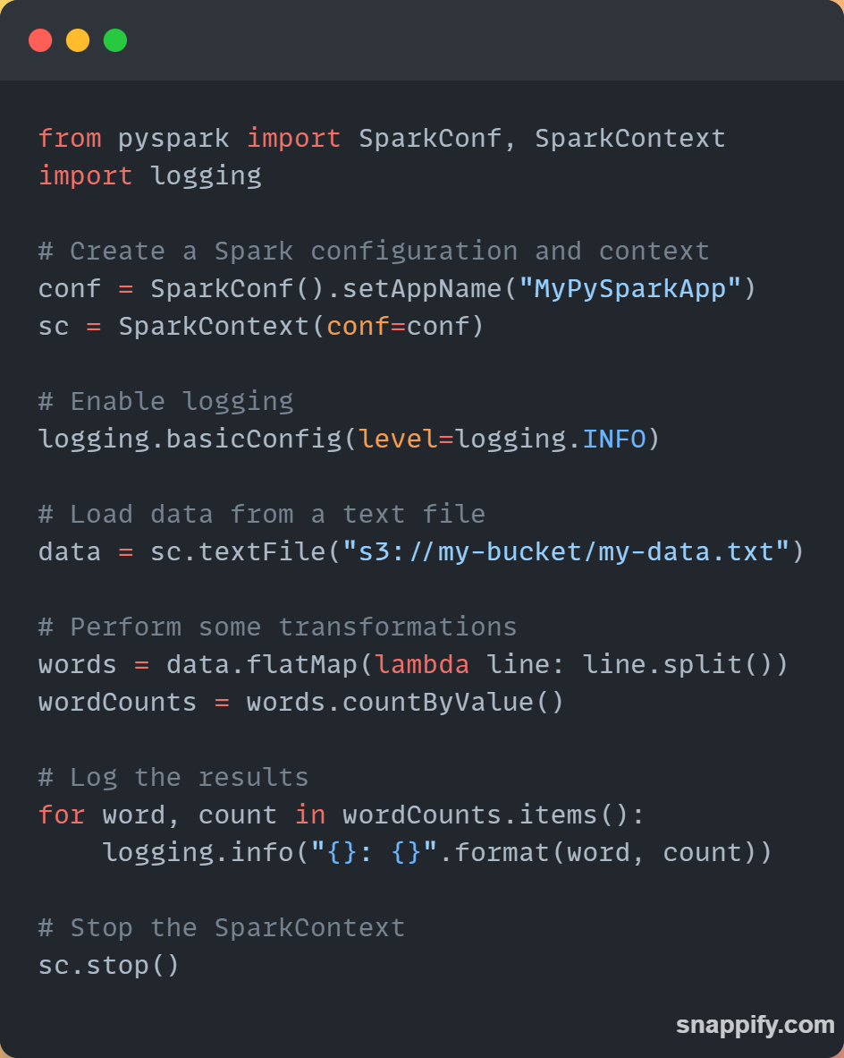
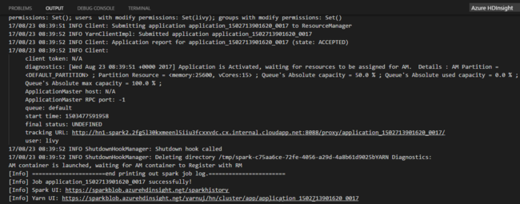
Monitoring and debugging
You can use native logging for information capture

Slide 10
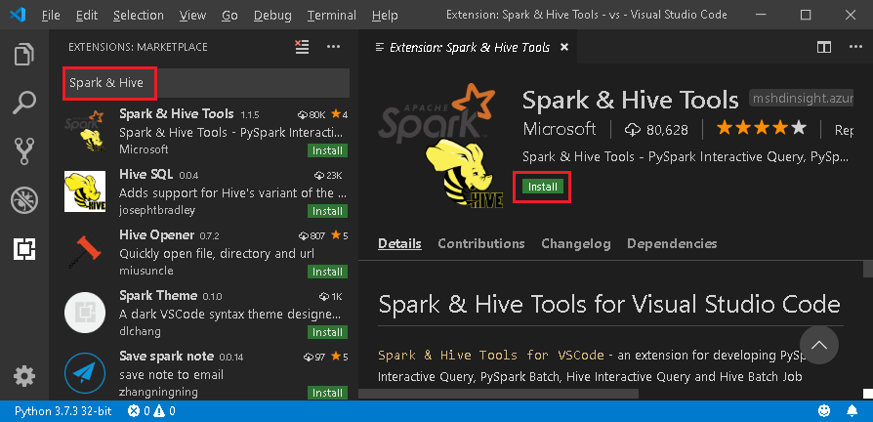
Monitoring and debugging
Logging
Built in logging for information capture
UI tools
PySpark supports popular debugging tools
e.g. PyCharm / Eclipse / VS code

Slide 11
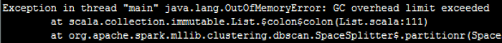
Cleanup
Garbage Collector in separate session
Stopping SparkContext
To release resources and free up memory
Clearing RDDs
Cleared to release memory
Closing database connections
Closing the database connections, to prevent data leaks too
Removing temporary files
Temporary files should be removed to free up disk space

Slide 12
Next…

